Slide 1

Vice President’s Office for People & Culture
Personal Integrity Office
The University of Basel is committed to a study, research, and working environment that respects the protection of personal integrity.
Violations of personal integrity are external assaults on a person as a whole. These are behaviors that overstep boundaries and harm an individual’s sense
of self-worth. They include, in particular, bullying, discrimination and sexual harassment. In addition, personal boundaries can also be violated in conflicts.

Slide 2

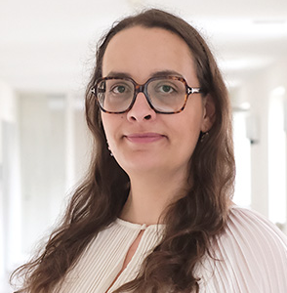
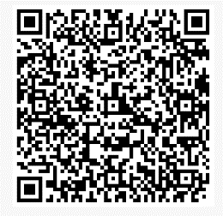
Personal Integrity Office
We provide confidential advice on all matters relating to the protection of
personal integrity. You decide on further steps yourself.
On request, we provide support as a neutral person – e.g. by helping you prepare
for a meeting or by anchoring a difficult conversation.
E-Mail
personalintegrity@unibas.ch
Phone Number
+41 61 207 09 99
Web
www.unibas.ch/personal-integrity
Dr. Cora Dollinger Dominika Hens

