Slide 1
Studying English at Basel
BA English
Dr. Zeynep Köylü & Dr. Ridvan Askin
Anglophone Linguistics and Literary Studies

Slide 2
Structure of Presentation
I. Our Department
II. Degree Structure
III. Mobility & Extracurricular Activities
IV. Studying at the University of Basel

Slide 3
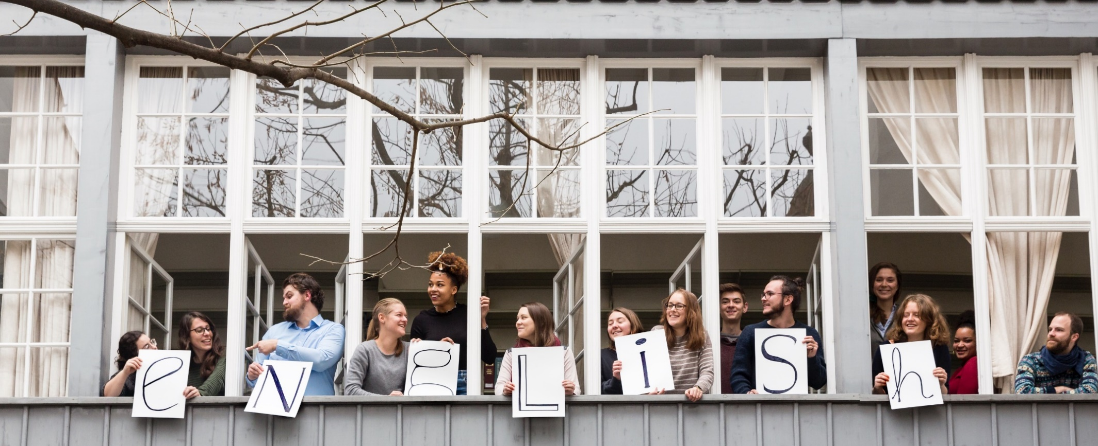
I. Our Department

Slide 4
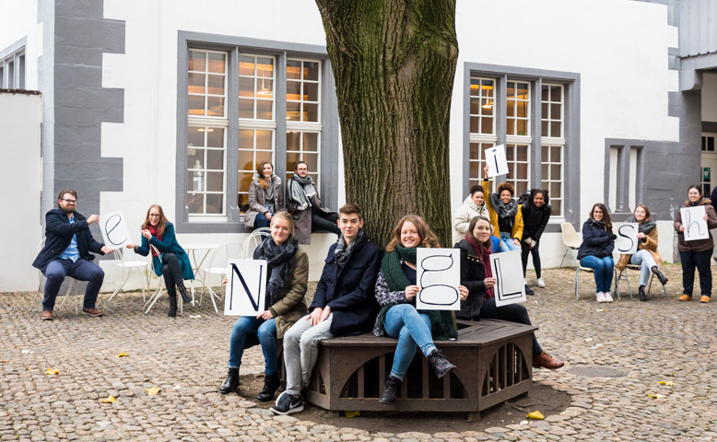
Nadelberg 6 & Nadelberg 4
Notes:
The Department of English is housed in two adjacent buildings on Nadelberg 6 plus some library space in Nadelberg 4, two minutes from the market square. The oldest of these, at the back of a cobbled courtyard, is also the oldest stone building in Basel. It was already called "Schönes Haus" ("Beautiful House") when it was first mentioned in a document in 1294, because of its wealth and decorative splendor. It is one of the few buildings that survived the earthquake of 1356.

Slide 5
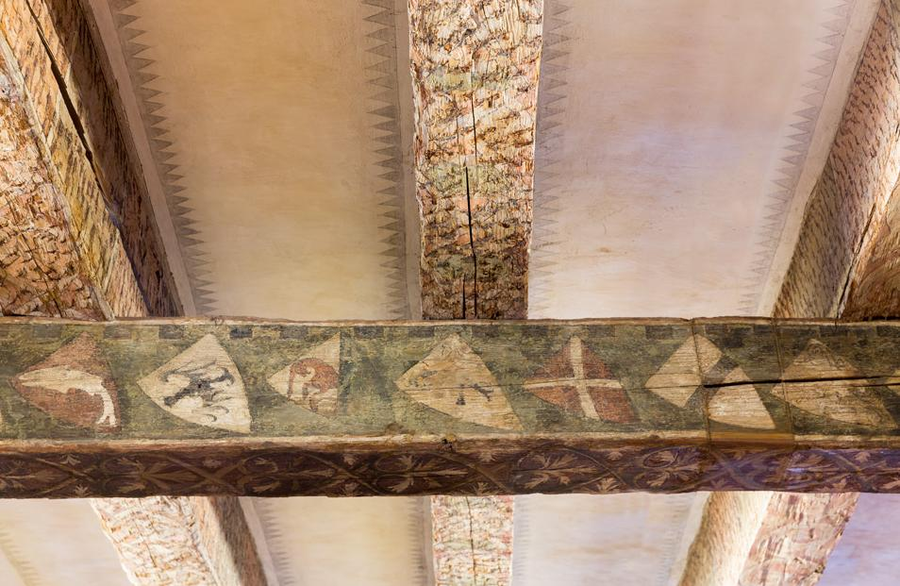
Nadelberg 6 & Nadelberg 4
Notes:
The premises are dominated by the Great Lecture Hall with its ceiling beams with mythical creatures, monsters, and zodiac signs painted on them. They are the only preserved secular painting of this kind in Europe. There is also a specialty coat of arms beam in the 1st floor library, and the wood from that beam comes from 1190 — likely the oldest Swiss coat of arms. The so-called “Gothic Room” on the 2nd floor is a library with a Gothic wooden ceiling saved from the ruins of another building.
We use this space as much as possible:
Our lectures take place in the Great Lecture Hall and the upstairs Room 11
The department library is located on the 1st and 2nd floors of Nadelberg 6 with some additional space in Nadelberg 4, which otherwise houses the German Department
All the instructors’ offices and the secretary’s office are located on the 1st and 2nd floors of Nadelberg 6
The cellar was converted into a studio theatre seating about 100 people
The courtyard hosts many social events including most of the activities by the Student Association (FG), Bloomsday, jazz festival events, and the summer productions of Shakespeare in the Courtyard from Upstart Theatre.
We may be a bit biased here, but we pride ourselves of offering one of the most beautiful study environments in all of Switzerland!

Slide 6
ENGLISH LINGUISTICS
Research Fields
English and Irish Literature since the Renaissance
Cultural Media, Drama and Theater
Literary History
North American and General Literature
Cognitive Linguistics
Sociolinguistics and the Sociology of English (e.g., Interaction, Politeness, etc.)
ANGLOPHONE LITERARY & CULTURAL STUDIES
Literary Theory
Language Acquisition
Computer-Mediated Communication
Translation and Interpreting Studies
Postcolonial Literatures and Cultures (includes all former British colonies and protectorates)
Notes:
These are some of the fields that our department covers across the two main areas of literary and cultural studies and linguistics. Each of these two areas has two professors with different research foci. All of us, your instructors, do not only teach but also do our own research, which you will notice in the topics of classes we offer, and our favorite hobby-horses that you will get to know during your studies.
We have about 20 full-time and part-time instructors and around 500 undergraduate and graduate students. We encourage you to check out the staff profiles on the department website. You might also want to check the University of Basel’s course listings for the last couple of years to get an idea of the range of courses we offer: https://vorlesungsverzeichnis.unibas.ch/de/recherche (Studiengänge und Module → Philosophisch-Historische Fakultät → Bachelorstudium → Englisch).

Slide 7
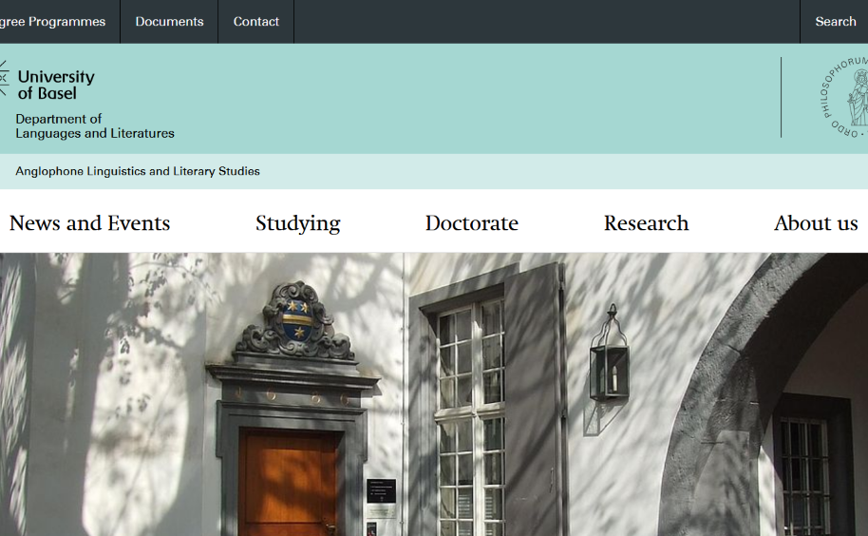
Website: english.philhist.unibas.ch
Notes:
Make sure to browse our website, which offers a wealth of information ranging from event announcements to study plans and manuals to the department’s research activities to information on the department’s history. In the “About Us” section, you will find all staff profiles. You might also want to browse our latest annual reports to get an idea of (academic) life at the department.

Slide 8


II. Degree Structure
Notes:
So how is the BA English organized? What awaits you if you enroll with us?

Slide 9
The BA in English (75KP)
INTRODUCTORY MODULES (41KP)
ADVANCED MODULES (25KP)
English Linguistics (16)
Anglophone Literary and Cultural Studies (16)
Academic Communication in English - ACE (9)
INTERPHILOLOGICAL (4KP)
Advanced English Linguistics (10)
Advanced Anglophone Literary and Cultural Studies (10)
Linguistics
Literary Studies
BACHELOR EXAM (5KP)
Seminar Paper (5)
BA English
Notes:
Here you can see the general make-up of the program and the requirements for obtaining your BA degree:
As freshers, your main concern will be the introductory modules in Linguistics, Anglophone Literary and Cultural Studies, and Academic Communication in English. Modules consist of courses in different formats (proseminars, seminars, lectures, excursions etc.) and proseminar and seminar papers.
Once you have completed your introductory modules, you can move on to the advanced modules, which build on and further refine the knowledge acquired in your study’s introductory phase.
You also need to take courses in Basel’s specialty interphilology module, in which you can choose from a variety of courses from all modern languages taught at Basel.
You cap off your studies with your written BA exam.
Let’s go over this in a bit more detail…

Slide 10
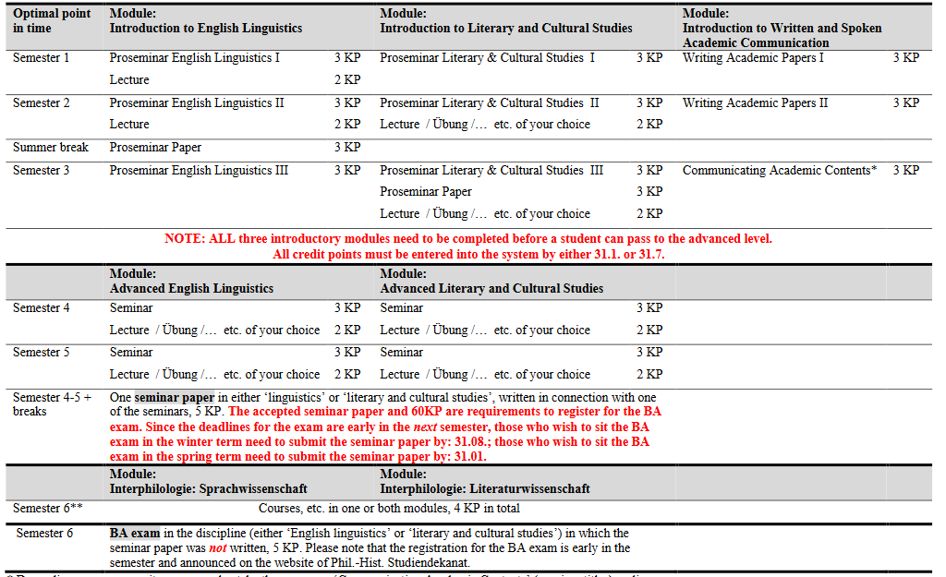
Notes:
This is our Sample Study Plan showing you what we believe to be the best and most efficient way of organizing your studies. This plan is available on our website.

Slide 11
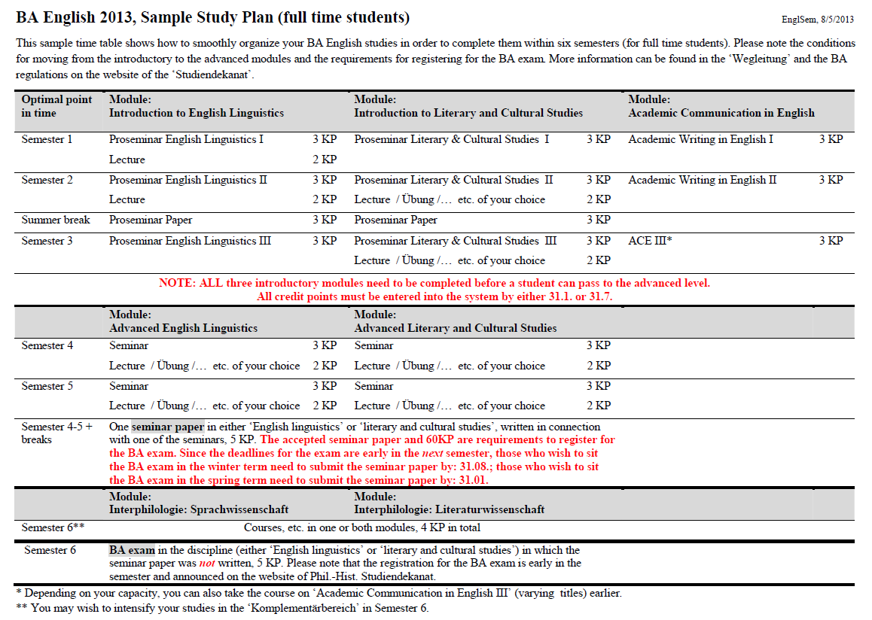
Basic BA studies
(semesters 1 - 3)
Advanced BA studies
(semesters 4 - 6)
Notes:
Generally, the BA English consists of an introductory and an advanced study phase. Let’s zoom in on the Basic Modules, that is, semesters 1-3.

Slide 12
Modul | Introduction to English Linguistics |  | Introduction to Anglophone Literary and Cultural Studies |  | Introduction to Academic Communication in English
Semester 1 | Proseminar English Linguistics I | 3 KP | Proseminar Anglophone Literary & Cultural Studies I | 3 KP | Academic Writing in English I | 3 KP
 | Vorlesung | 2 KP
Semester 2 | Proseminar English Linguistics II | 3 KP | Proseminar Anglophone Literary & Cultural Studies II | 3 KP | Academic Writing in English II | 3 KP
 | Vorlesung | 2 KP | Vorlesung / Übung /… etc. nach Wahl | 2 KP
Summer break and Semester 3 | Proseminararbeit | 3 KP | Proseminararbeit | 3 KP
Semester 3 | Proseminar English Linguistics III | 3 KP | Proseminar Anglophone Literary & Cultural Studies III | 3 KP | Academic Communication in English III | 3 KP
 |  |  | Vorlesung / Übung /… etc. nach Wahl | 2 KP
Note: Only after you have completed ALL of these modules, can you move on to the Advanced Modules.
Notes:
This is what we believe to be the ideal path for your first three semesters of study. As you can see, this comprises two introductory proseminars each in linguistics and literary and cultural studies, two courses focusing on essay writing, one proseminar paper in linguistics and literature each, three topical proseminars in the three areas of study, and a number of lectures and/or other courses such as excursions. The department offers both recurrent lectures in linguistics and literary history and theory and one-off lectures on specific aspects of Anglophone cultures. Each term, you will have a variety of courses to choose from.

Slide 13
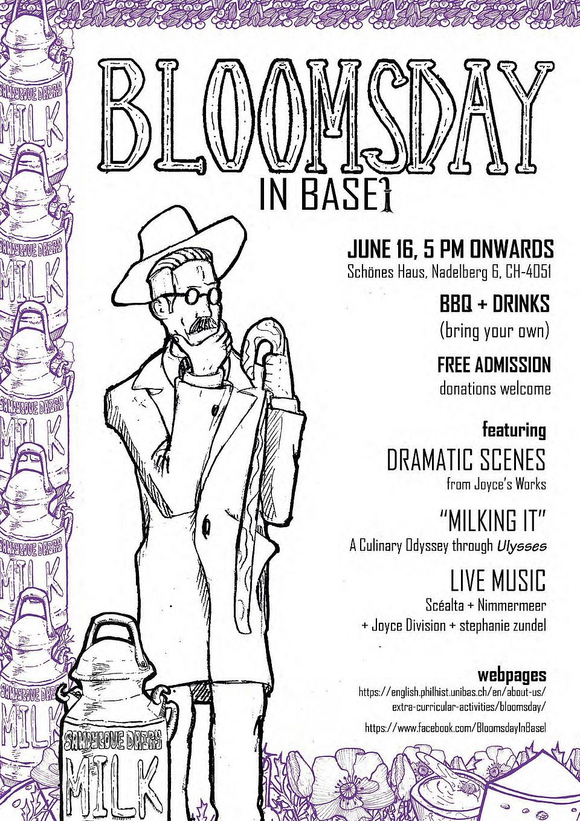
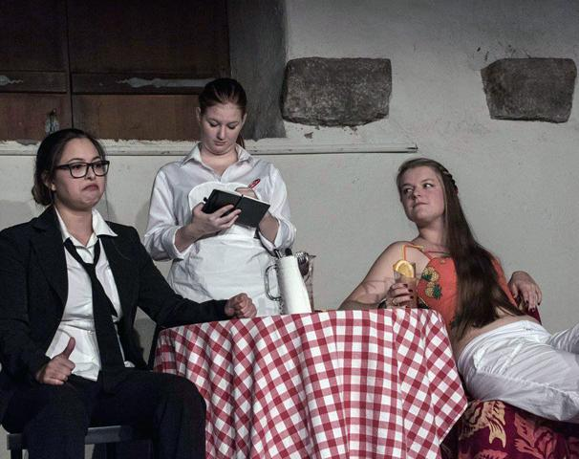
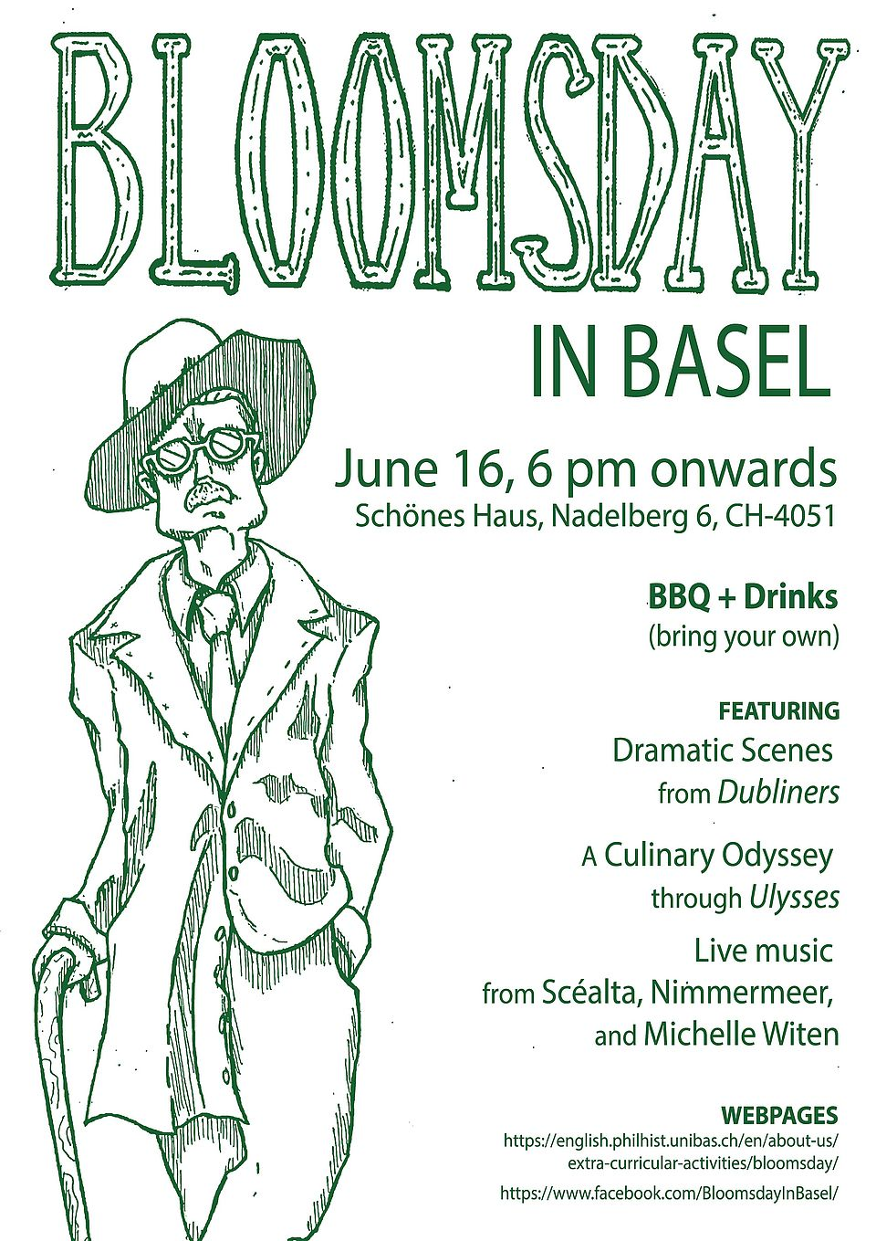
III. Mobility & Extracurricular Activities
Notes:
But studying English means more than just studying. Let’s have a look at the extracurricular activities we have on offer, many of which are actually student-run. Also, if you opt to study English in Basel, you will have access to other regional and international players in higher education.

Slide 14
Mobility
EUCOR – The European Campus
All Basel students are eligible to attend courses at our EUCOR partner universities Freiburg i. Br., Mulhouse, and Strasbourg
Studying Abroad
  Something to think about for after your 3rd semester, but should be planned sooner rather than later
  The English Department and the University of Basel have teamed up with a range of international partner institutions to provide you with the best possible study abroad experience
  Contact: Simone Sumpf (studienberatung-dslw@unibas.ch)
  Mobility Office
  Excursions…

Slide 15
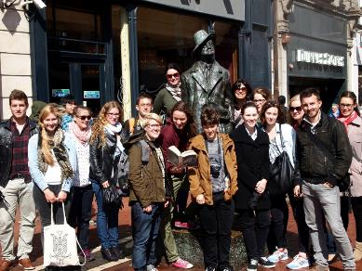
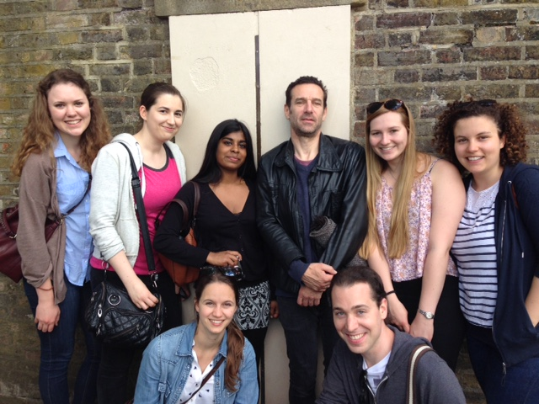
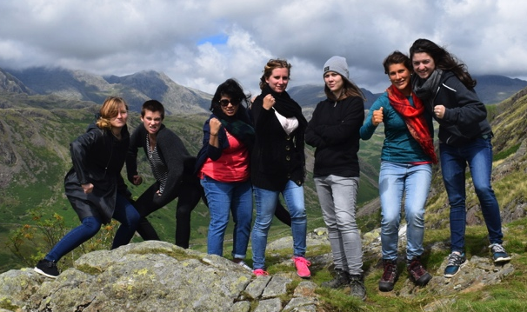
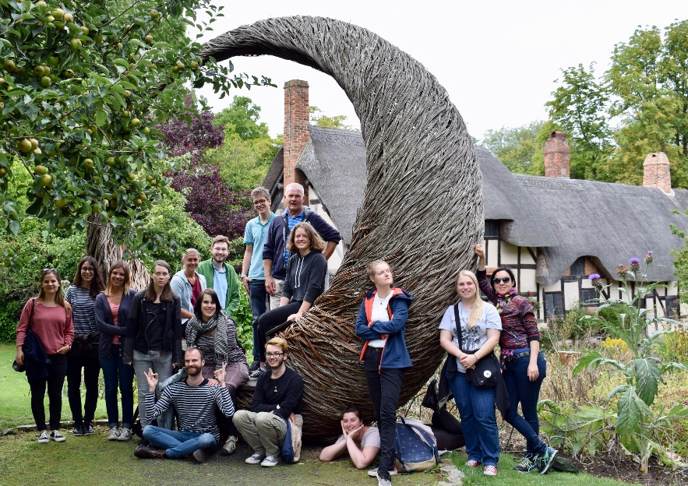
Dublin, Ireland
(2014)
London, UK
(2015)
The Lake District, UK
(2016)
Stratford-upon-Avon, UK
(2013, 2015, 2017, 2019)
Excursions!!
Notes:
Every other year, the department organizes a week-long excursion to Stratford-upon-Avon, which includes 4-5 productions at the Royal Shakespeare Theatre, pre- and post-performance talks with actors and members of the production teams, theater related workshops, and academic lectures. In addition, instructors regularly organize excursions related to the courses they teach – the slide features pictures from a selection of such excursions from the last couple of years.

Slide 16

Extracurricular Opportunities and Support
Student Association (Fachgruppe Englisch)
The Gay Beggars
Mind-Map
English Seminar Choir
Notes:
The Student Association is the official representation of students vis-a-vis the department and the university. They also regularly organize get-togethers, BBQs, film screenings, and parties, particularly for our freshers. The Gay Beggars are our theater group. They put on 1-2 spectacular productions per year in our intimate cellar theater – not to be missed! Both the Student Association and The Gay Beggars welcome new, active members. The same is true of the English Seminar Choir and Mind-Map, a student-run organization focusing on mental health founded by English students. As you can see, there are plenty of opportunities to get involved and become an active member of our small but thriving community!

Slide 17


IV. Studying at the University of Basel

Slide 18
Kurze Wege
Notes:
Except for Dentistry, Environmental Sciences, Law, and Economics, all University of Basel institutions and facilities are located close to the Rhine and to each other.

Slide 19
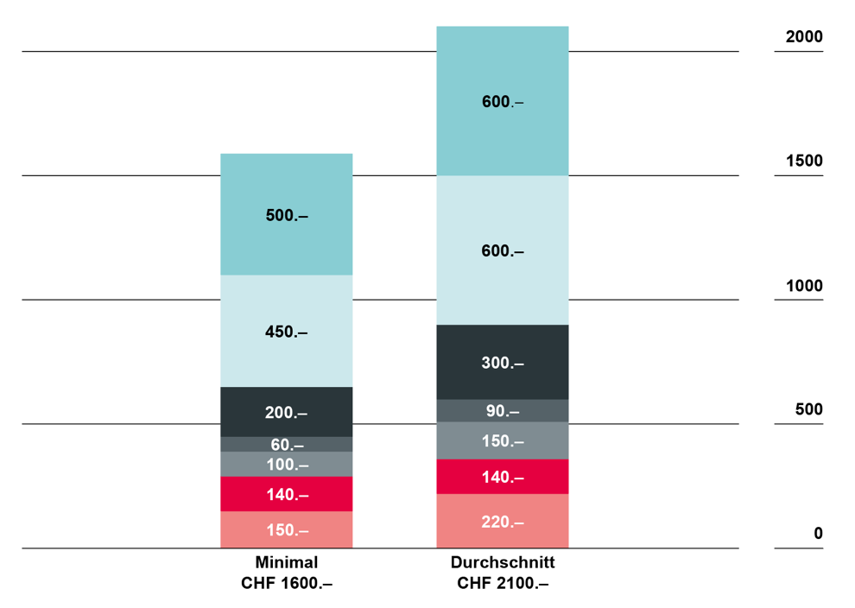
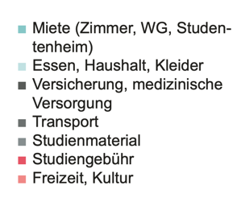
Living Costs for Studying in Basel

Slide 20
Frequently Asked Questions
When can I start the BA in English?
The BA English starts in the autumn term. Candidates who wish to study English have to apply online for admission. The registration deadline for each autumn term is 30 April.
How long does it take to study English at the BA level?
The BA is conceived as a three-year course of full time study. It may, however, be taken part time; this results in prolonged studies.
With what other BA subjects can the BA English be combined?
In general, the BA English can be combined with any other BA subject offered by the Faculty of Humanities and Social Sciences and a selection of other subjects from other faculties at the University of Basel.
Are there language requirements for studying English?
You should have an advanced level of English (Matura level, C1) as all our courses are taught in English and you are expected to be able to follow. The department does not offer English language acquisition courses.

Slide 21
Contact
Website: english.philhist.unibas.ch
Simone Sumpf, Student Advisor DSLW: studienberatung-dslw@unibas.ch
Dr. Zeynep Köylü (linguistics)
zeynep.köylü@unibas.ch
Dr. Ridvan Askin (literary and cultural studies)
ridvan.askin@unibas.ch
Notes:
Please do shoot us an email anytime if you have any questions concerning our BA program!

Slide 22
Additional Information
If you want to see some of our teaching staff in action, do check out our sample teaching videos on Info Day website.
If you want to hear about studying at Basel from the student’s point of view, we encourage you to get in touch with our student association.
If you want to experience some actual live teaching, we offer you the opportunity to join our spring term courses for one or two sessions. If you are interested, please get in touch with Dr. Ridvan Askin (ridvan.askin@unibas.ch).

Slide 23
Thank You!
Questions?

